Slide 1

Topological Sorting and Strongly Connected Components
Data Structure | Graph
Course: Data Structure | Chapter: Graph | Bachelor of Engineering
DISCOVER · LEARN · EMPOWER
Notes:
Welcome everyone to today's lecture on Graphs. We will dive deep into two critical algorithms: Topological Sorting and Strongly Connected Components. These concepts are essential for scheduling tasks and analyzing network dependencies in real-world engineering systems.

Slide 2
Course Outcomes
SLIDE 2 / 14
Course Outcome
CO | BT LEVEL | DESCRIPTION
CO1 | BT1 | Understand and apply basic data structures, algorithms, complexity analysis, ADTs, arrays and linked lists.
CO2 | BT2 | Apply and implement stacks and queues in problem-solving.
CO3 | BT3 | Analyse and apply searching, sorting, and hashing techniques.
CO4 | BT4 | Construct and apply tree structures and traversal techniques.
CO5 | BT5 | Represent and solve graph problems using DFS, BFS, and graph algorithms.
Chandigarh University
2 / 14
Notes:
This lecture directly addresses Course Outcome 3. You will learn to analyze graph structures and apply sorting techniques specifically for Directed Acyclic Graphs. This skill is fundamental for solving dependency resolution problems in software engineering.

Slide 3
Learning Objectives
SLIDE 3 / 14
Learning Outcomes
1
Define topological sorting and its strict requirements for DAGs.
2
Apply Kahn's algorithm to generate valid linear orderings.
3
Identify strongly connected components using Tarjan's algorithm.
4
Analyze time complexity differences between DFS and Kahn's methods.
5
Solve practical dependency resolution problems using these graph techniques.
Chandigarh University
3 / 14
Notes:
By the end of this session, you will be able to define topological sorting and distinguish it from standard sorting. You will apply Kahn's algorithm to generate valid orderings and identify strongly connected components using Tarjan's method. We will also analyze the time complexity differences between these approaches.

Slide 4
Lecture
SLIDE 4 / 14
Definition of Topological Sorting
1
Topological sort orders vertices linearly respecting directed edges.
2
It requires a Directed Acyclic Graph (DAG) with no cycles.
3
If edge u to v exists, u must appear before v.
4
Multiple valid orderings can exist for a single graph structure.
5
It is distinct from numerical sorting of vertex labels.
6
Applications include task scheduling and dependency resolution in build systems.
Chandigarh University
4 / 14
Notes:
Topological sorting arranges vertices in a linear sequence where every directed edge points from an earlier to a later vertex. Crucially, this is only possible if the graph is a DAG, meaning it has no cycles. Unlike numerical sorting, the order depends on dependencies, not values. For example, you cannot compile code B before code A if B depends on A.

Slide 5
Kahn's Algorithm
SLIDE 5 / 14
In-Degree Approach
1
Calculate in-degree for every vertex in the directed graph.
2
Initialize a queue with all vertices having zero in-degree.
3
Dequeue a vertex and add it to the sorted result list.
4
Decrement in-degree of all adjacent neighbors of the dequeued vertex.
5
Enqueue any neighbor whose in-degree drops to zero immediately.
6
Repeat until the queue is empty and all vertices are processed.
Chandigarh University
5 / 14
Notes:
Kahn's algorithm relies on the concept of in-degree, which counts incoming edges for each node. We start by placing all nodes with zero incoming edges into a queue. As we process a node, we remove its outgoing edges, effectively reducing the in-degree of its neighbors. If a neighbor's in-degree hits zero, it becomes ready for processing and enters the queue.

Slide 6
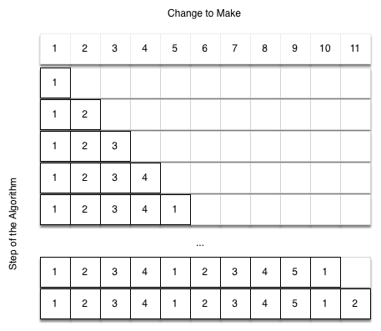
Worked Example
SLIDE 6 / 14
Kahn's Algorithm
GOVERNING EQUATION
Initial in-degrees: A=0, B=1, C=1, D=2
PROCESS A
Remove A, update B and C; new in-degrees B=0, C=0.
FINAL TOPOLOGICAL ORDER
A, B, C, D or A, C, B, D.
• Graph has vertices A, B, C, D with edges A→B, A→C, B→D, C→D.
• Queue starts with [A] since only A has zero in-degree.
• Queue becomes [B, C]; process B then C; D becomes ready.
Source: runestone.academy
Chandigarh University
6 / 14
Notes:
Let's trace this with a simple graph. We start with A having zero in-degree. After processing A, both B and C have their in-degrees reduced to zero. We can process B then C, or C then B, leading to two valid orderings. Finally, D becomes available only after both B and C are processed. This demonstrates how dependencies dictate the sequence.

Slide 7
Lecture
SLIDE 7 / 14
DFS-Based Topological Sort
1
Perform a Depth First Search traversal on the entire graph.
2
Push each vertex onto a stack immediately after visiting it.
3
The stack top contains the vertex with the highest finish time.
4
Pop vertices from the stack to get the topological order.
5
This method naturally handles the reverse post-order requirement.
6
It is often easier to implement recursively than Kahn's method.
Chandigarh University
7 / 14
Notes:
The DFS approach is an elegant alternative to Kahn's algorithm. We traverse the graph recursively and push a vertex onto a stack only after all its descendants have been visited. This ensures that a vertex appears after all its dependencies in the final stack order. When we pop elements from the stack, we get the correct topological sort.

Slide 8
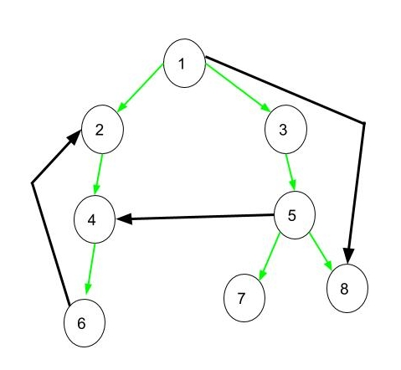
Lecture
SLIDE 8 / 14
Detecting Cycles in Graphs
1
Topological sort is impossible if the graph contains any cycle.
2
Kahn's algorithm detects cycles if the result list is incomplete.
3
A cycle exists if vertices remain unprocessed after queue empties.
4
DFS detects cycles by finding a back-edge to an ancestor.
5
A back-edge indicates a path from a descendant to an ancestor.
6
Cycle detection is a critical validation step before sorting.
Source: media.geeksforgeeks.org
Chandigarh University
8 / 14
Notes:
If a graph has a cycle, no topological ordering exists because you cannot order elements that depend on each other. Kahn's algorithm will fail to process all vertices if a cycle is present. Similarly, DFS will detect a back-edge, which is an edge pointing to an ancestor in the recursion stack. This confirms the presence of a loop in the dependency structure.

Slide 9
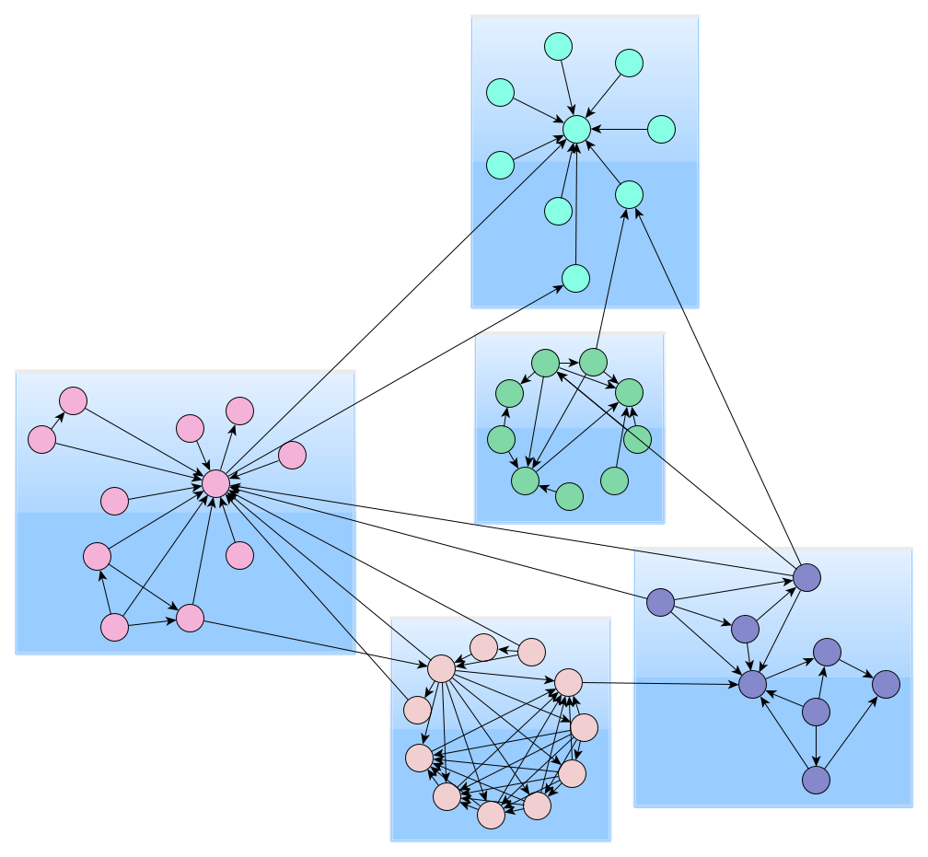
Lecture
SLIDE 9 / 14
Strongly Connected Components Defined
1
A Strongly Connected Component is a maximal subgraph where every node reaches every other.
2
In a DAG, each vertex is its own single-node component.
3
In a general directed graph, components form a condensed DAG.
4
Condensing components simplifies complex graph analysis significantly.
5
Tarjan's algorithm finds these components in linear time complexity.
6
SCCs are vital for analyzing reachability in social or web networks.
Source: www.yworks.com
Chandigarh University
9 / 14
Notes:
A strongly connected component is a group of vertices where you can travel from any node to any other node within that group. In a Directed Acyclic Graph, every node is its own component. However, in graphs with cycles, these components form clusters. Condensing these clusters into single nodes creates a new DAG, which simplifies the analysis of the entire network structure.

Slide 10
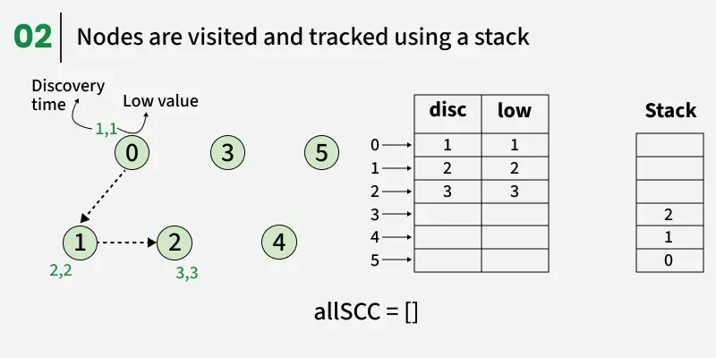
Tarjan's Algorithm
SLIDE 10 / 14
Discovery
1
Maintain a discovery time and low-link value for each vertex.
2
Discovery time records when a vertex is first visited.
3
Low-link value tracks the lowest discovery time reachable via back-edges.
4
Use a stack to keep track of vertices currently in the component.
5
When low-link equals discovery time, a new component is found.
6
Pop vertices from the stack until the current vertex is reached.
Source: media.geeksforgeeks.org
Chandigarh University
10 / 14
Notes:
Tarjan's algorithm uses two key values: discovery time and low-link value. The discovery time is simply when we first visit a node. The low-link value tracks the earliest node reachable from the current node, including through back-edges. When these two values match, it means we have found the root of a strongly connected component. We then pop all nodes from the stack to form the component.

Slide 11
Worked Example
SLIDE 11 / 14
Tarjan's Algorithm
1
Consider a graph with cycle A→B→C→A and edge C→D.
2
DFS visits A, then B, then C; stack holds [A, B, C].
3
C has back-edge to A; low-link of C becomes discovery of A.
4
C's low-link equals A's discovery; component {A, B, C} identified.
5
Pop A, B, C from stack; they form one SCC.
6
D is visited next; D forms its own SCC {D}.
Chandigarh University
11 / 14
Notes:
Let's trace this with a cycle A, B, C. We visit A, then B, then C. C has a back-edge to A, so its low-link value updates to A's discovery time. Since C's low-link matches A's discovery, we identify {A, B, C} as a single component. We pop them from the stack. Node D is then visited and forms its own component since it has no back-edges to the cycle.

Slide 12
Lecture
SLIDE 12 / 14
Common Pitfalls and Errors
1
Attempting topological sort on a graph with cycles causes infinite loops.
2
Ignoring back-edges in DFS leads to incorrect low-link calculations.
3
Failing to reset visited flags between disconnected graph components.
4
Confusing weak connectivity with strong connectivity in undirected graphs.
5
Not handling isolated vertices correctly in SCC algorithms.
6
Assuming a unique topological order exists for every DAG.
Chandigarh University
12 / 14
Notes:
Students often try to sort a graph with cycles, which is impossible. Another common error is ignoring back-edges when calculating low-link values, leading to incorrect component identification. You must also ensure you reset visited flags for disconnected components. Finally, remember that topological order is not always unique; multiple valid orderings can exist.

Slide 13
Lecture
SLIDE 13 / 14
Key Takeaways
1
Topological sort orders DAG vertices respecting directed edge dependencies.
2
Kahn's algorithm uses in-degrees while DFS uses finish ×.
3
Cycle detection is mandatory before attempting topological sorting.
4
Strongly Connected Components group mutually reachable vertices together.
5
Tarjan's algorithm efficiently finds SCCs in linear time O(V+E).
Chandigarh University
13 / 14
Notes:
To summarize, topological sorting is a linear ordering of vertices in a DAG that respects dependencies. We can achieve this using Kahn's algorithm or DFS. Cycle detection is a prerequisite for this process. Strongly Connected Components group mutually reachable vertices, and Tarjan's algorithm finds them efficiently. These tools are essential for analyzing complex dependency networks.

Slide 14
Lecture
SLIDE 14 / 14
References
DATA STRUCTURES
A Pseudocode Approach with C — Gilberg, Forouzan
• Data Structures — Lipschutz
• Data Structure Using C — AK Sharma
• C and Data structure — P. S. Deshpandey
Chandigarh University
14 / 14
Notes:
For further reading, please refer to the standard textbooks listed here. Gilberg and Forouzan provide excellent pseudocode approaches. Lipschutz offers a comprehensive theoretical foundation. Sharma and Deshpandey provide practical C implementations. These resources will help you master the algorithms discussed today.

